Slide 1
FORDCS V1.0 Lifecycle ROADMAP
Vienna, March.2022
Full-Stack Software Project Development Method (SwPDM)
Edu Platform
MSc. Ömer Karacan
karacankos@gmail.com

Slide 2



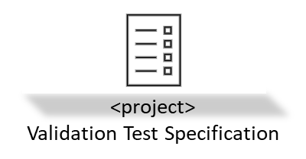
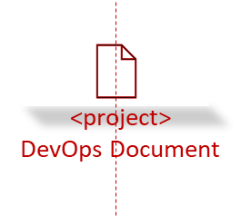

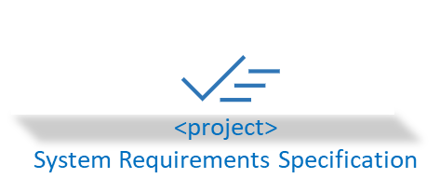
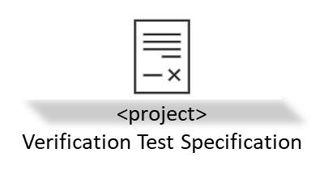
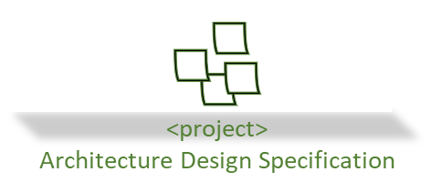
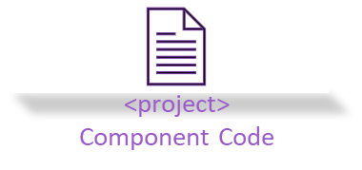

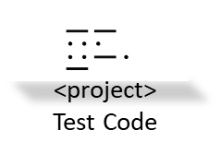
FORDCS V1.0 SwPD Lifecycle Status
→ process
Change the check item to green if done!
Epics
Planning (DOC)
Development (DOC)
Delivery (DOC)
Pre-condition: Customer needs are understood!
Pre-condition: Customer requirements are analyzed!
Pre-condition: Aligned with Project Plan!
Define the Statement of Work / Describe project Purpose
Describe Customer Requirements
Describe project Technical Scope
Describe project Release Plan
Define project Artifacts
Describe project Additional Considerations
Maintain project References
Define and Describe Annex (if any)
Define System Requirements
Define System/Software Architecture
Implement & Verify
Integrate & Validate
Describe and Setup Development & Production Environment (DevOps)
Produce Release & Assure Content Quality
<project>
Product Release
Abbr.
DOC … documentation

